Slide 1



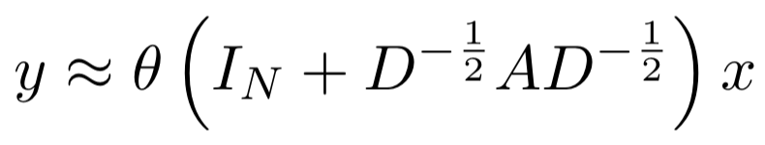
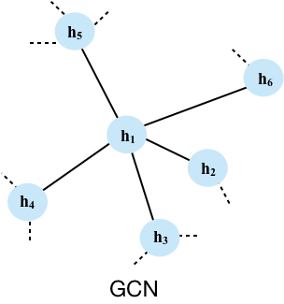
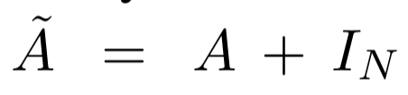
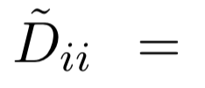
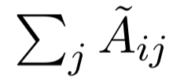
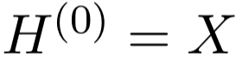
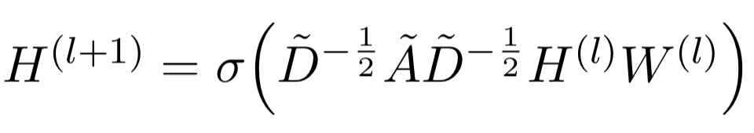
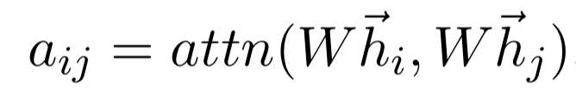
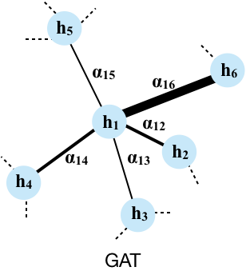
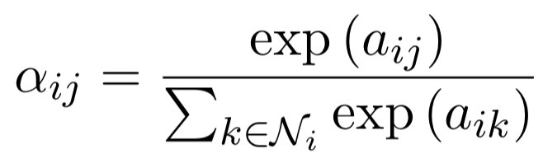
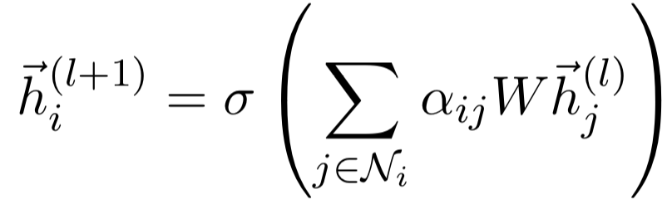
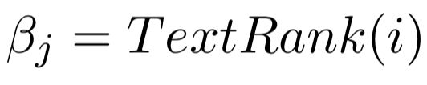
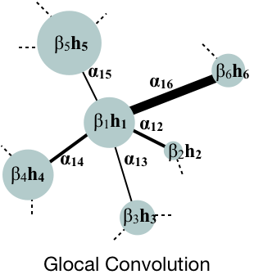
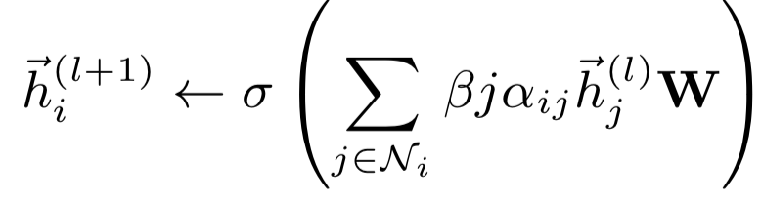
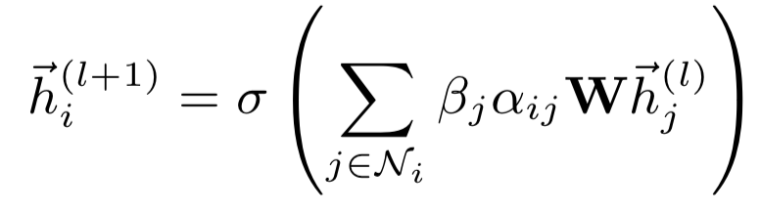
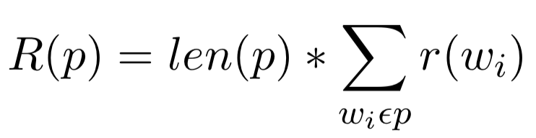
Glocal: Incorporating Global Information in Local Convolution for Keyphrase Extraction
Animesh Prasad and Min-Yen Kan
School of Computing, National University of Singapore
{animesh, kanmy}@comp.nus.edu.sg
Introduction
Experiments & Results
Motivation:
Sequential labeling models fail to scale well for large documents.
Current State of the Art:
Feature-rich candidate selection and ranking techniques or sequence labeling over a subset of the document (e.g., Abstract)
Key Observations:
structure of the graph formed by the text concurrence is not exploited.
random walk scores are used as-is, without incorporation
of semantic features or fine-tuning via supervision.
Proposed Glocal (global–local portmanteau)
Incorporate random walks as importance (Global)
Learn from node specific features (Local: Self)
Use neighborhood to enhance node-specific features (Local: Neighborhood)
Results: Performance on 3 full-text datasets (†abstract only)
Performance Breakdown on the SemEval Dataset
Method
Graph Convolutional Network
Graph Attention Network
Glocal Convolution
TextRank based importance cannot be learned locally.
Steps:
1) Construct text graph per document where each node is a token and edges are co-occurrences in neighborhood.
2) Train the Glocal model on graph with binary classification target (keyphrase, ¬keyphrase).
3) During testing, use the output probability to re-rank and generate multi-token keyphrases as:
Aggregates features in a well- defined neighborhood over normalized adjacency
Aggregates features in a soft neighborhood over normalized pair-wise parametrized adjacency
Discussion
Feature versus Scaling:
5% gain on average by incorporating as scaling as compared to up to 2% gain as features.
Graph Node Embeddings:
TextRank-scaled averaged node neighborhood embedding:
Longer, more Meaningful Keyphrases:
Up to 4% higher ratio of keyphrases of length 3+ and 3% higher keyphrases of length 2.
Future Directions:
1) Generalisation of Glocal for text classification, and its use in other extraction/ranking tasks such as summarization.
2) End-to-end graph-based ranking models
Aggregates features in a soft neighborhood over normalized pair-wise parametrized adjacency and scales features to their global importance
References:
[1]: Rada Mihalcea and Paul Tarau. TextRank: Bringing order into text. In Proceedings of Empirical Methods in Natural Language Processing. Association for Computational Linguistics, 2004.
[2]:Rui Meng, Sanqiang Zhao, Shuguang Han, Daqing He, Peter Brusilovsky, and Yu Chi. Deep keyphrase generation. In Proceedings of the 55th Annual Meeting of the Association for Computational Linguistics (Volume 1: Long Papers), pages 582–592. Association for Computational Linguistics, 2017.
[3]: Thomas N Kipf and Max Welling. Semi-supervised classification with graph convolutional networks. In Proceedings of International Conference for Learning Representations, 2016.
[4]: Petar Velicˇkovic ́, Guillem Cucurull, Arantxa Casanova, Adriana Romero, Pietro Liò, and Yoshua Bengio. Graph attention networks. In Proceedings of International Conference on Learning Representations, 2018.

